Slide 1

HOUSE PRICE
PREDICTION
LONDON
Sanjay Raju

Slide 2


PROBLEM
OVERVIEW
Over the past few years, the housing market in the London area has experienced fluctuations attributed to:
Pandemic Impact (2020-2021)
Economic Uncertainty and Recovery (2021-2022
Interest Rate and Inflation Concerns (2023-2024)
Long-term Predictions and Government Policies (2024-2025
Sample Footer Text
2/7/20XX

Slide 3
PREDICTIVE MODEL NECCESITY
Rapid market changes
Readily Available data
Technologically innovative time-period
DATASET OVERVIEW
Contains over 200,000 properties (post cleaning)
Details up to 25 features per each property (post cleaning)
Includes initial price value recorded from a historical point and from a recent point.

Slide 4
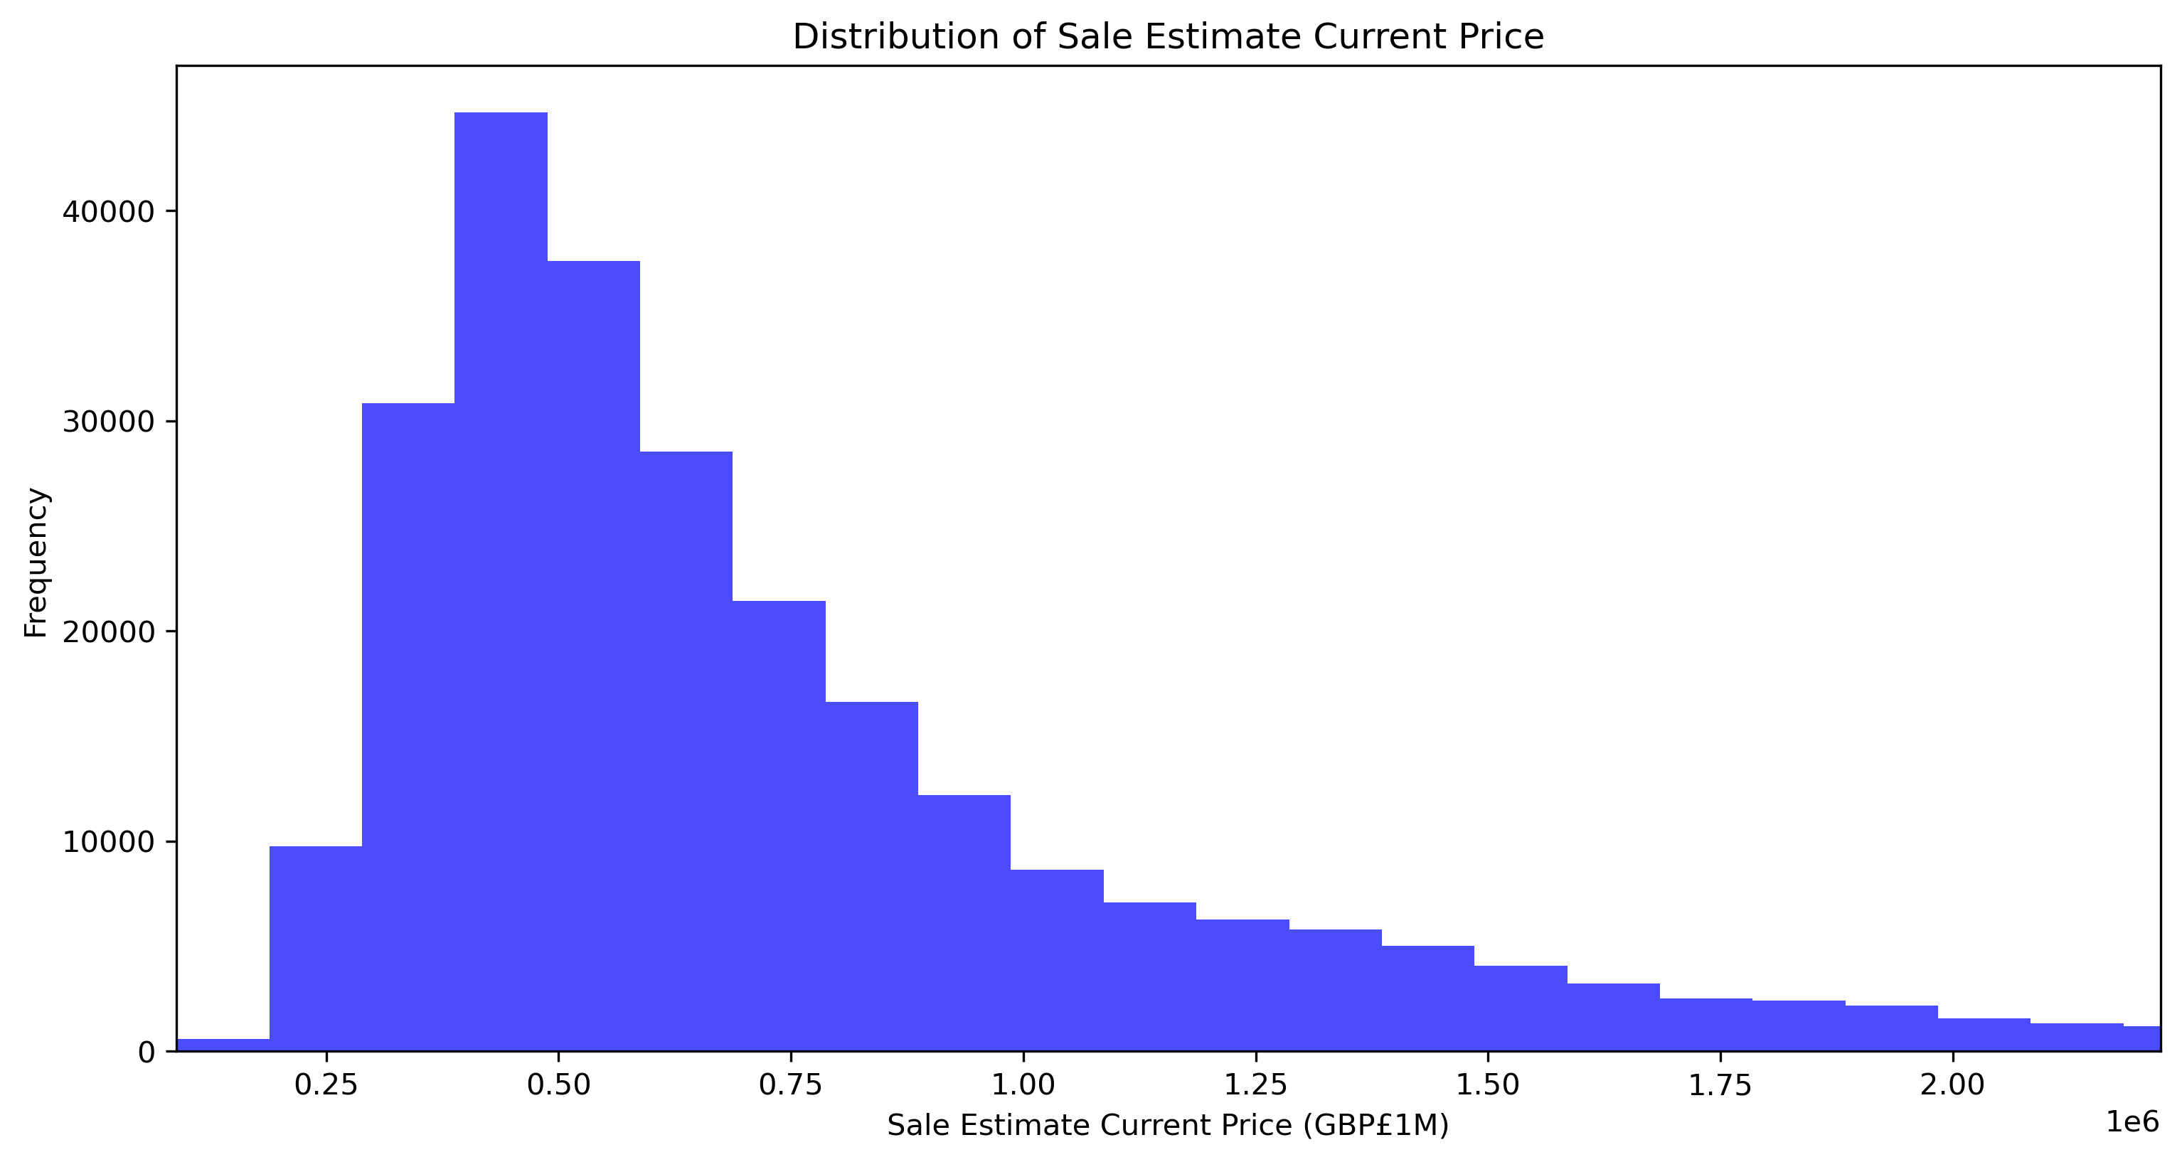
UNIVARIATE PLOT – DISTRIBUTION OF TARGET VARIABLE
Statistic measure | Price (£GBP)
Minimum value | 89,000
Maximum value | 17,844,000
Mean | 867,979
Median | 619,000
Std | 804,371

Slide 5
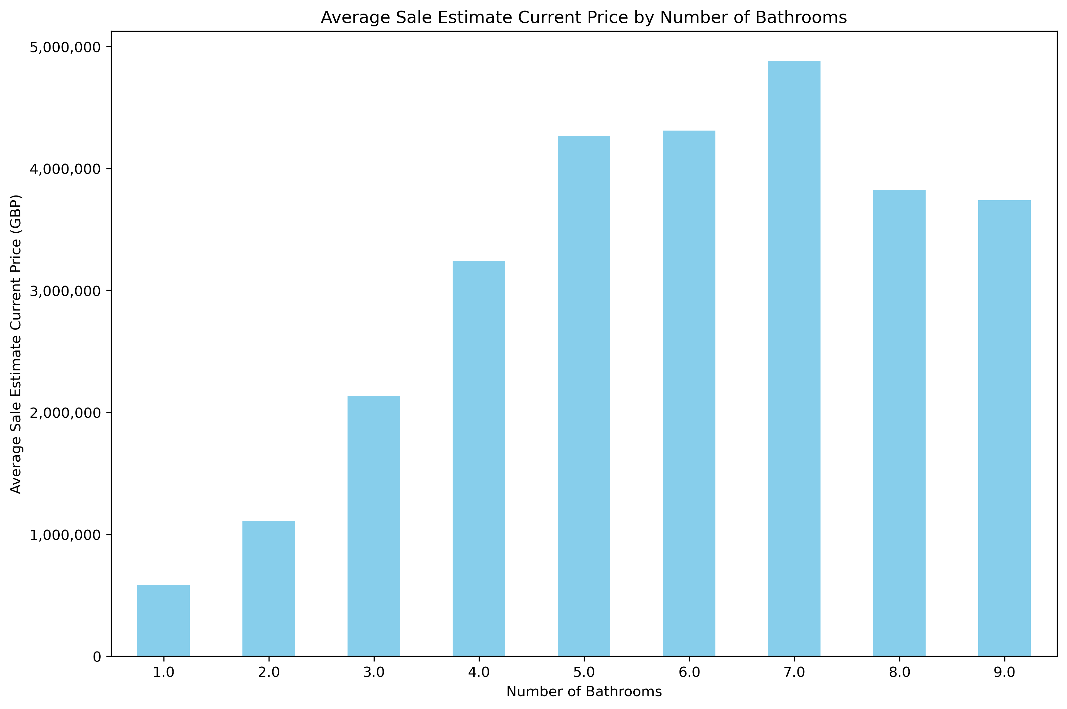
BIVARIATE PLOT – NO. OF BATHROOMS

Slide 6
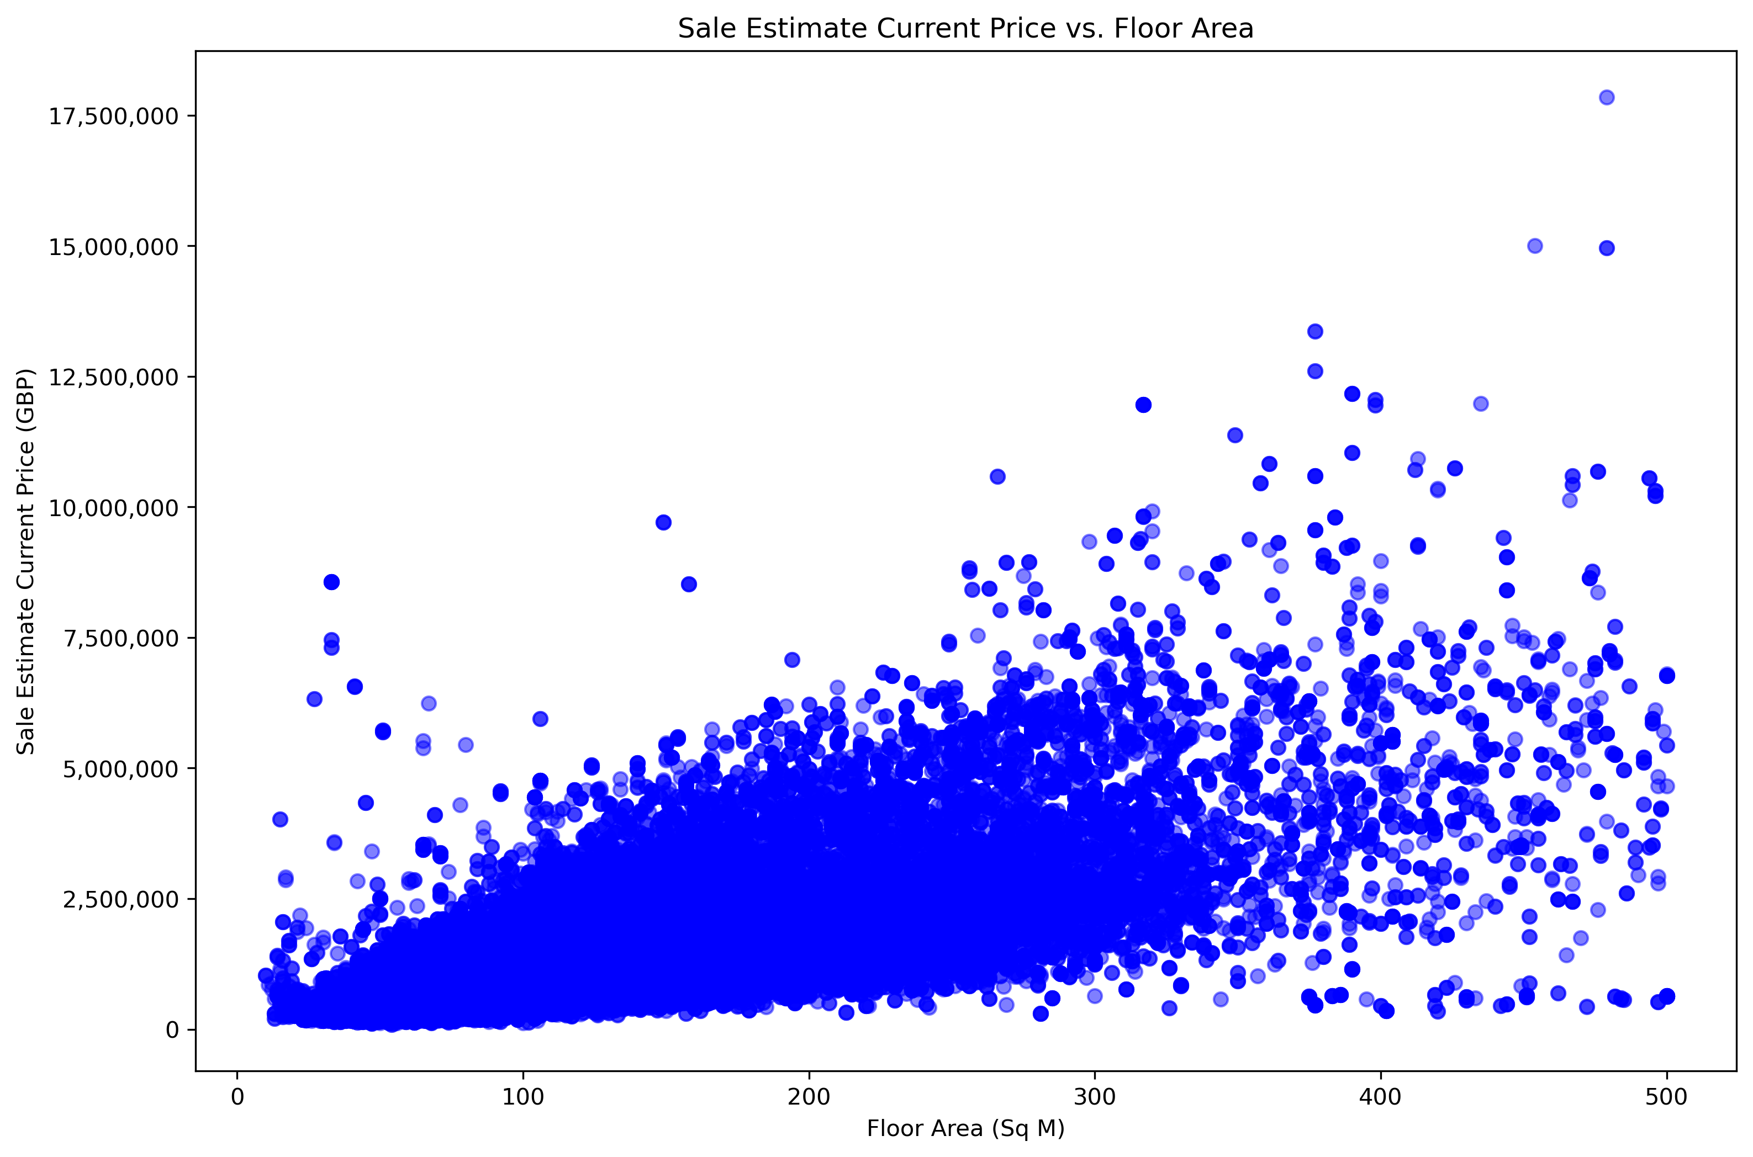
BIVARIATE PLOT – FLOOR AREA (SQ M)

Slide 7
NEXT STEPS
Conduct further analysis into the features which may have additional impact such as location or out code
Conduct statistical tests to determine whether the data is related or co-linear
Examine and determine which statistical models are best for this problem

